Slide 1
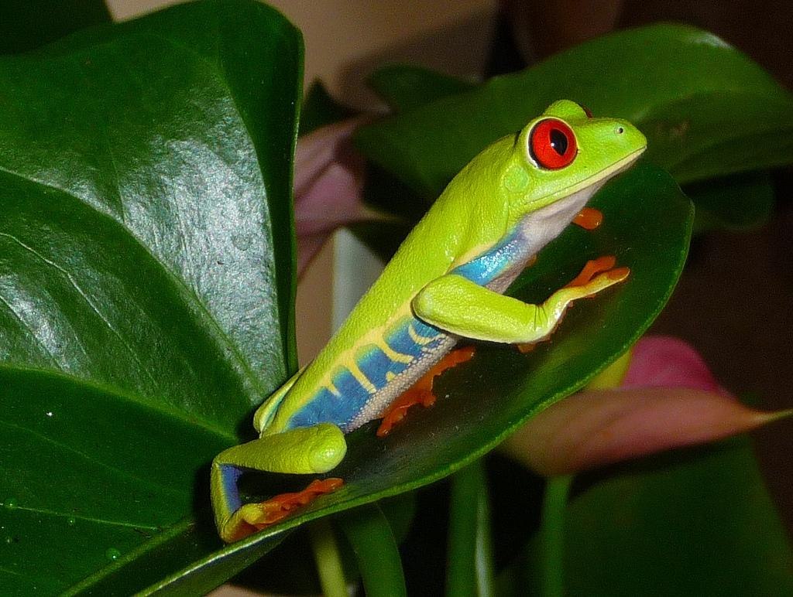
Population Ecology
Photo Credit: http://www.flickr.com/photos/dotlizard/3523774458/

Slide 2

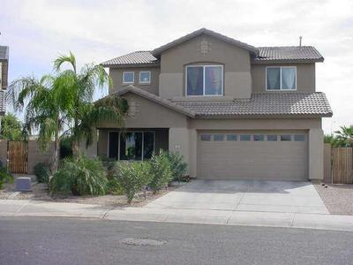
Ecology: the study of interactions of organisms with other organisms and the environment
(word means "study of house")

Slide 3
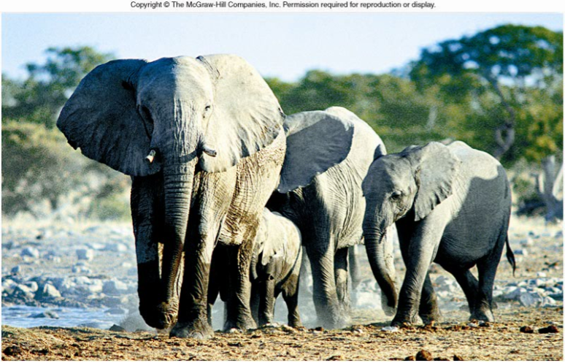
CO 46
Population: members of the same species living in the same area

Slide 4
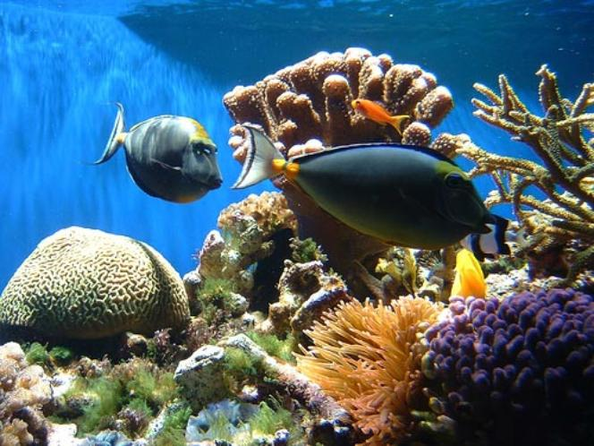
Community: all the different populations in an area

Slide 5
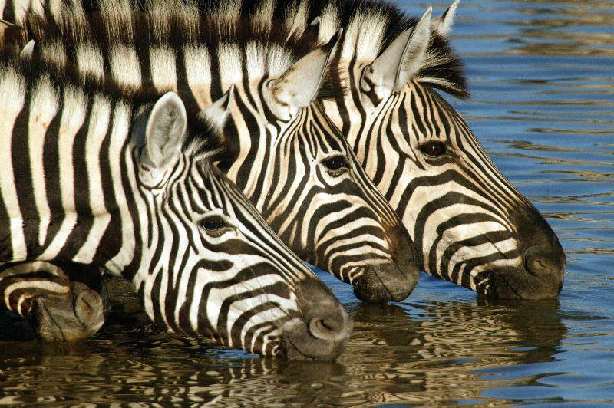
Population or Community?

Slide 6
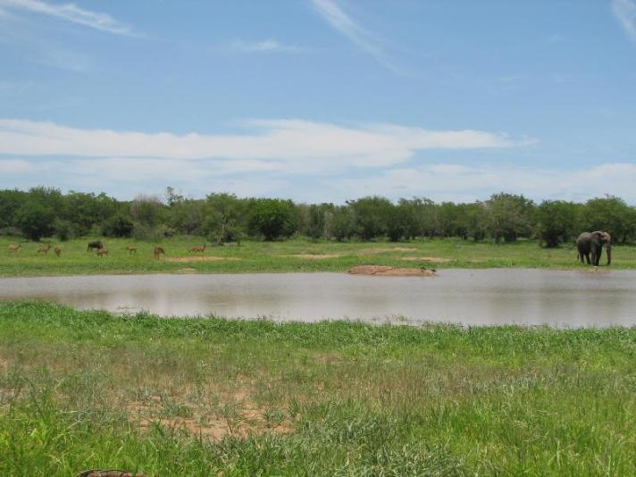
Ecosystem: the community plus the nonliving factors

Slide 7
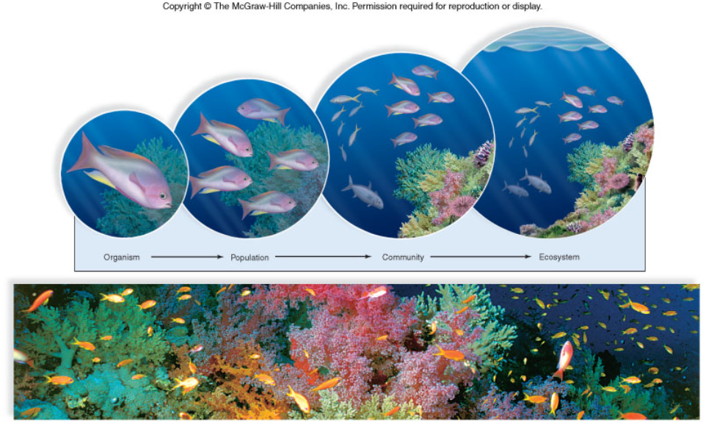
Figure 46.1

Slide 8

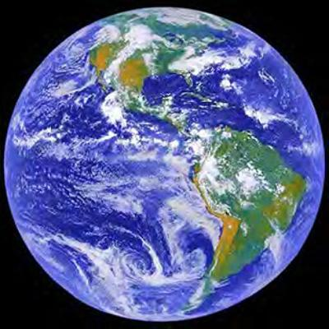
Biosphere: all the areas of the earth that supports life

Slide 9
Demography - the statistical study of a population (i.e. density, distribution, growth rate)
Population density: number of individuals per unit area (e.g. 6 zebras per square kilometer)
Population distribution: pattern of dispersal (i.e. random, clumped, uniform)

Slide 10
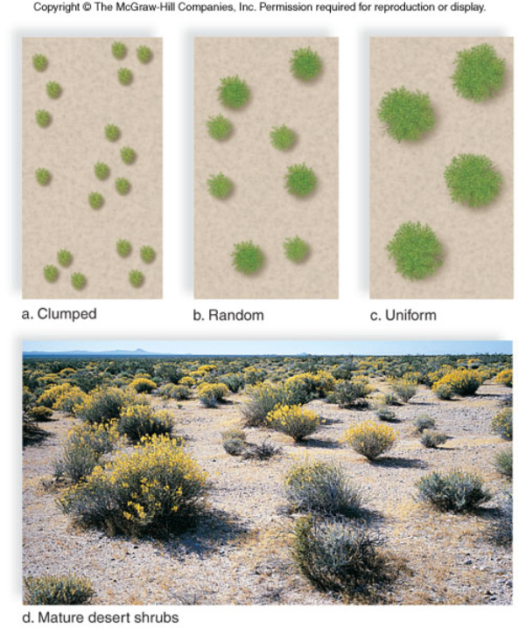
Figure 46.2

Slide 11

How Populations Grow
1. births 2. deaths 3. migration
Stable populations occur when as many individuals join (birth or immigration)
as leave (death or emigration)

Slide 12
Population change (r) =
(birth - deaths) + (immigrants - emigrants)
Biotic Potential: maximum rate at which a population could grow given optimal conditions (e.g. plenty of food, water, space)
Factors that influence biotic potential:
1. age of reproduction 2. frequency of reproduction 3. number of offspring produced 4. reproductive life span 5. average death rate under ideal conditions

Slide 13
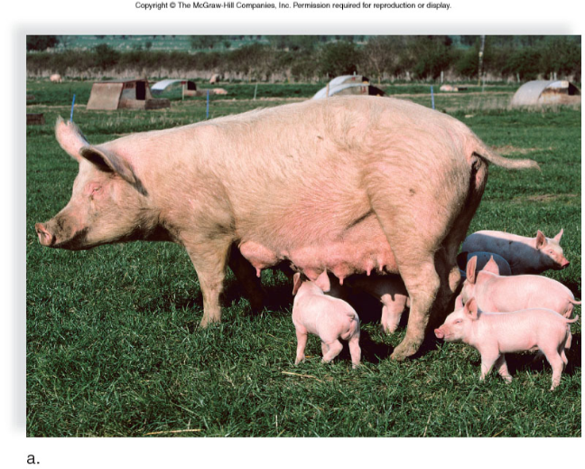
Compare the Biotic Potential…

Slide 14
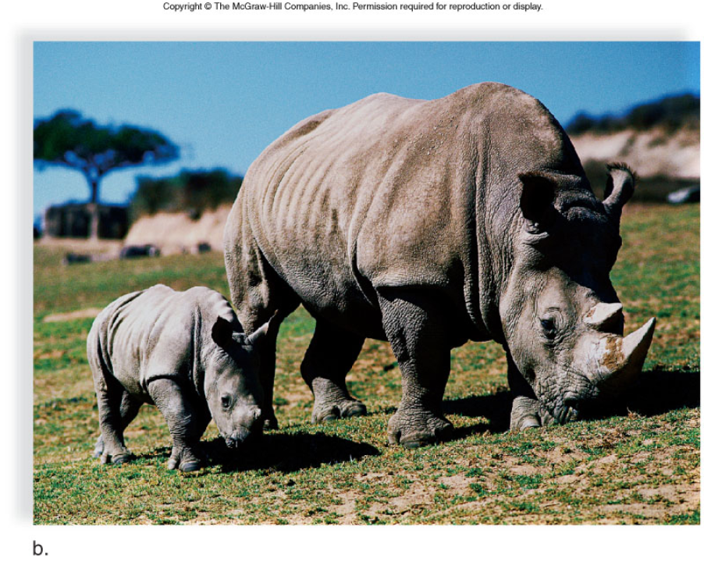
Figure 46.3b

Slide 15
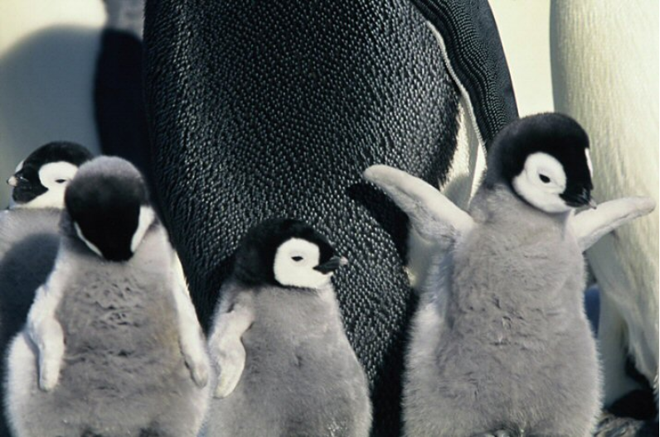

Slide 16
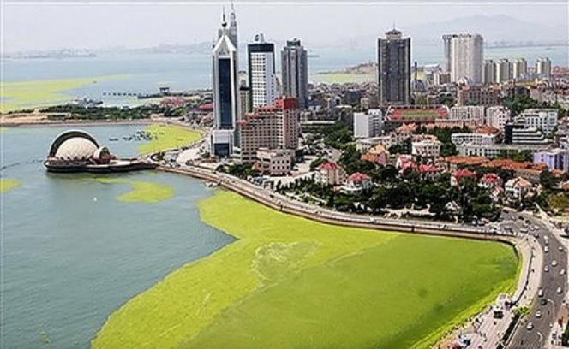
Don't forget, a population can refer to plants, fungi and bacteria…..
Algae bloom

Slide 17
SURVIVORSHIP CURVES
Survivorship curve - probability of newborn individuals surviving to a particular age
Late Loss (Type I) Constant loss (Type II) - death is often unrelated to age Early loss (Type III)

Slide 18
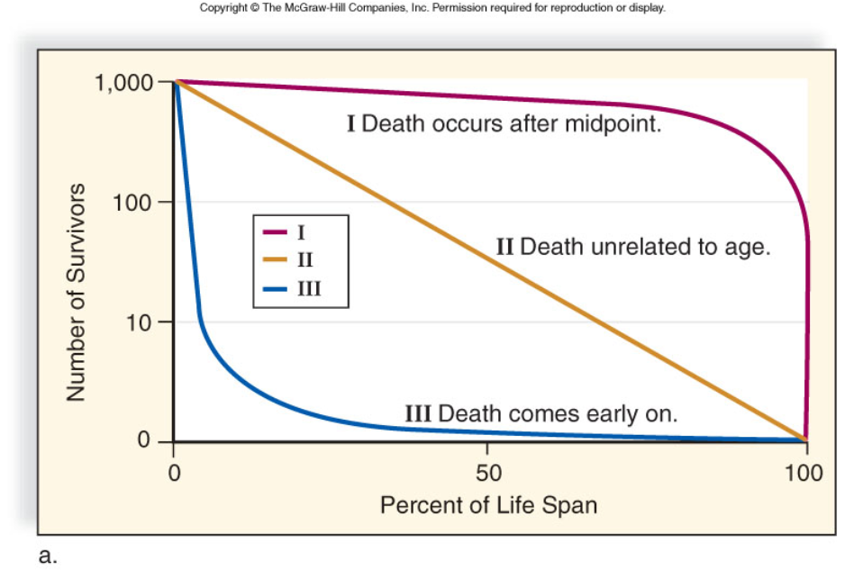
Figure 46.4a

Slide 19
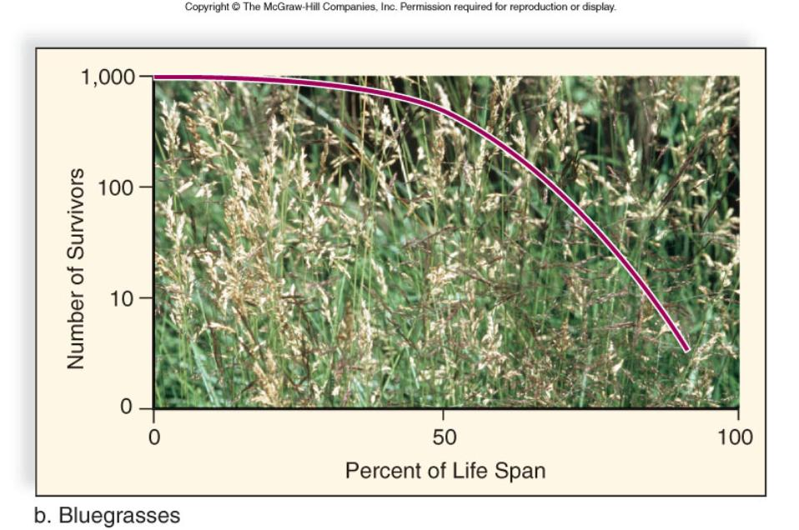
Figure 46.4b

Slide 20
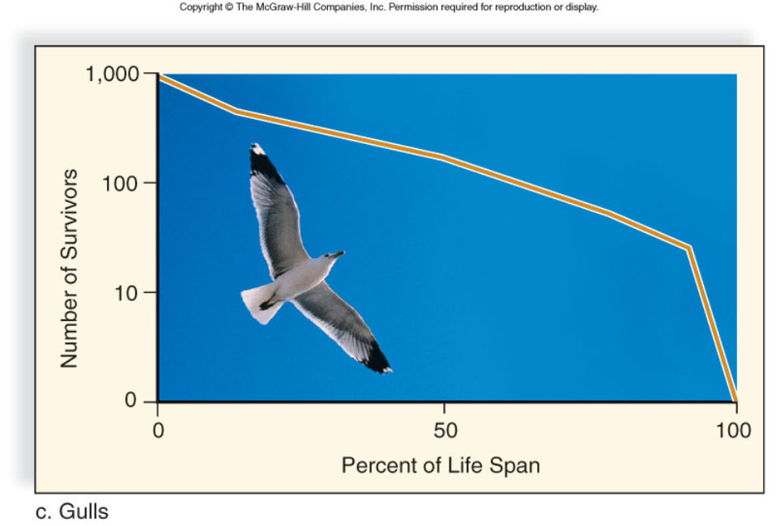
Figure 46.4c

Slide 21
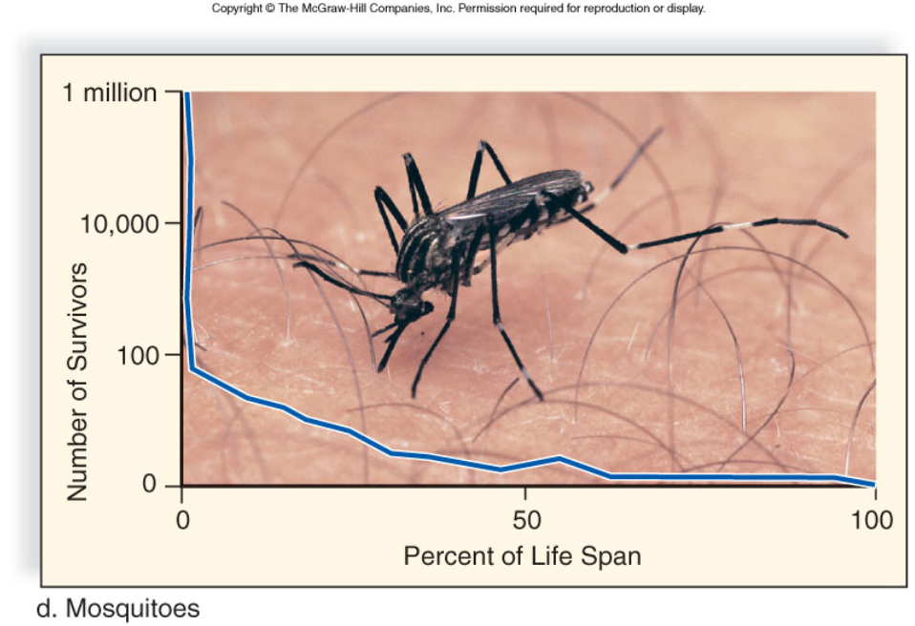
Figure 46.4d

Slide 22
Population Growth Models
Discrete Breeding: Reproduction occurs once in life (followed by death) - this is also called a Boom and Bust Cycle
Continuous Breeding: occurs throughout lifetime

Slide 23
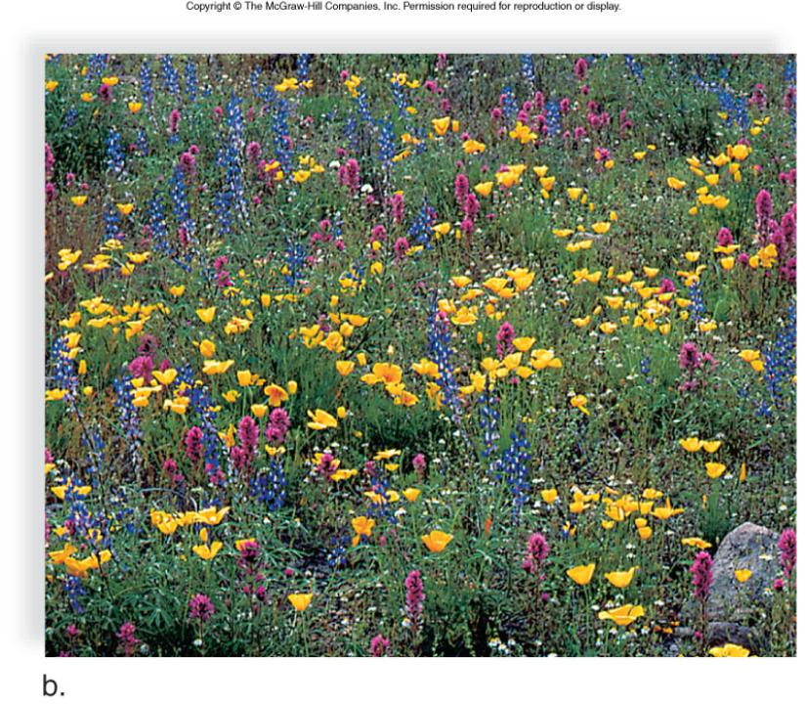
Figure 46.6b

Slide 24
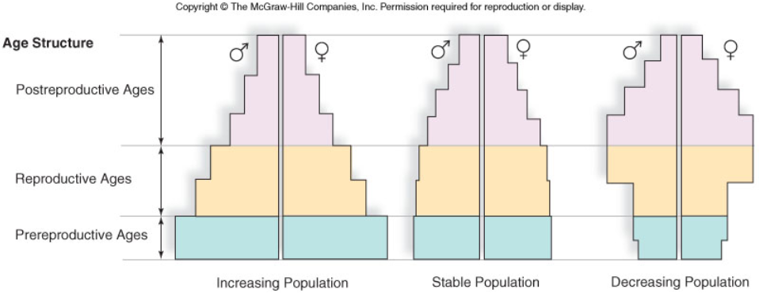
AGE STRUCTURE DIAGRAMS

Slide 25
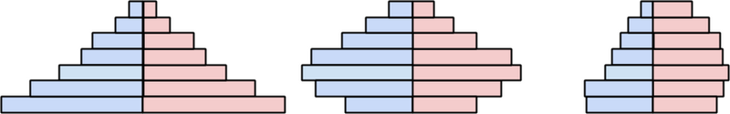
AGE STRUCTURE DIAGRAMS
1. Which one shows a declining birth rate?
2. Which one shows a growing population?
3. Which one might indicate a situation where males are not as likely to survive? Suggest a reason why this might happen in some cultures?

Slide 26
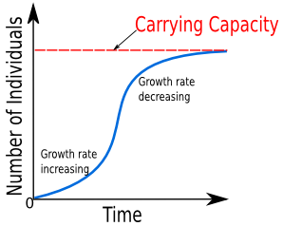
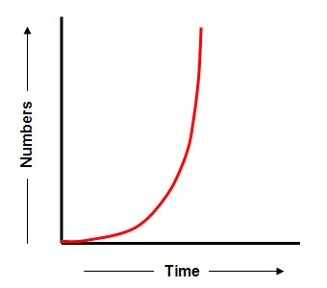
Exponential vs Logistic Growth
Logistic = S-shaped Curve
Lag Phase, exp growth phase, Deceleration, Stable Equilibrium Phase
Carrying Capacity: the maximum size of a population that an area can support
Exponential = J-shaped curve
Lag Phase then Exponential Growth
This population has not yet reached its carrying capacity.
Requires unlimited resources

Slide 27
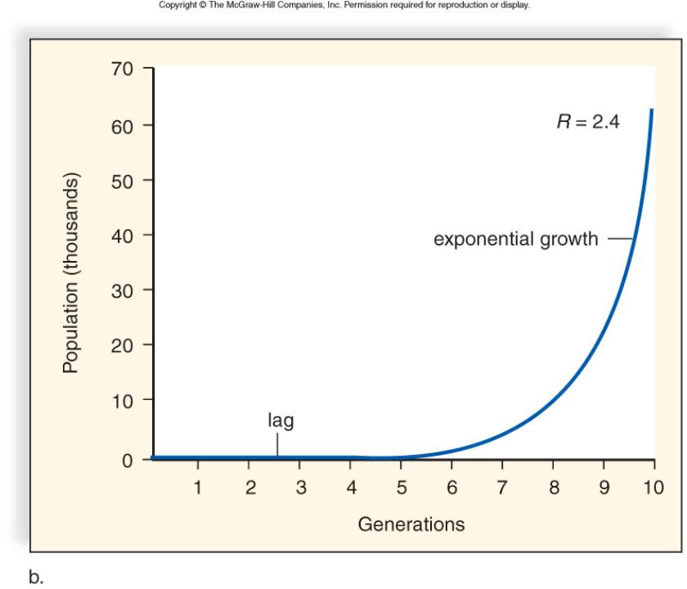
Figure 46.7b

Slide 28
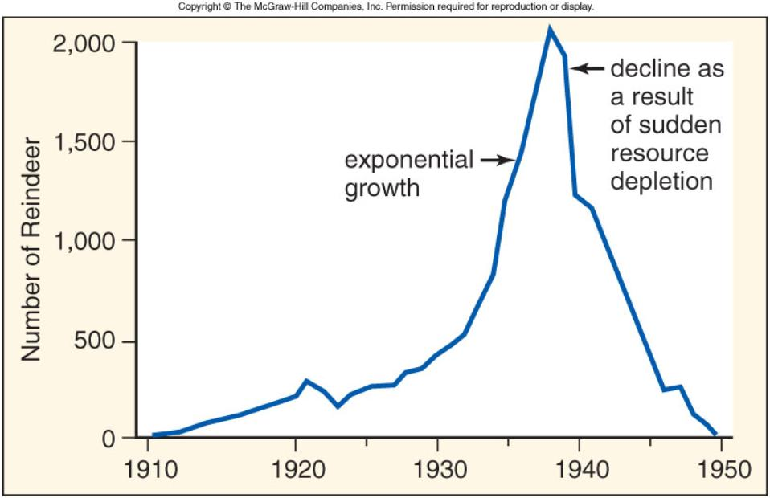
If the carrying capacity is exceeded, the population can decline fast due to resource depletion.

Slide 29
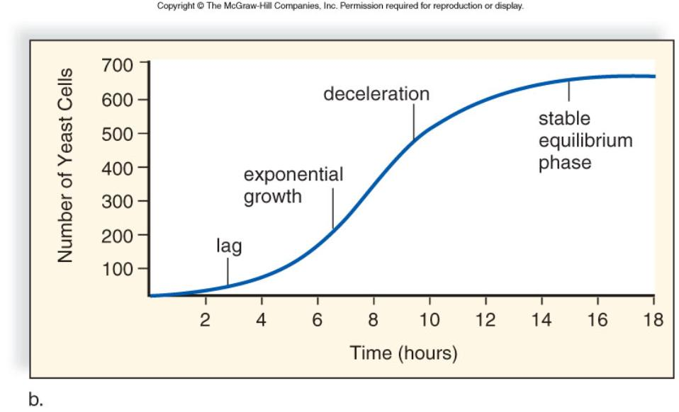
Figure 46.8b

Slide 30
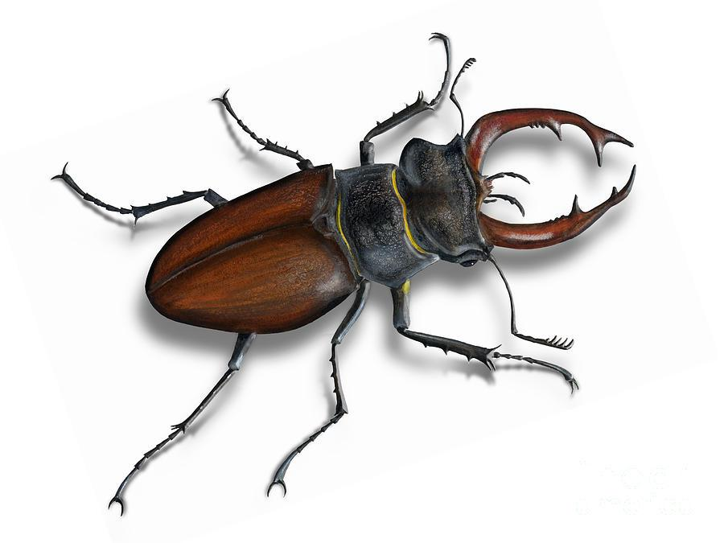
Population Growth Formula
Growth rate (r) = birth rate (b) - death rate (d)
[birth rate = # of births / total] [death rate = # of deaths / total]
Practice Problem: In research on beetles, you estimate that the populations size is 3000. Over the course of a month, you record 400 births and 150 deaths.
What is the growth rate (r)?
Population growth = rN
(r = growth rate, N = original population size)
Calculate the population growth of the beetle population.

Slide 31
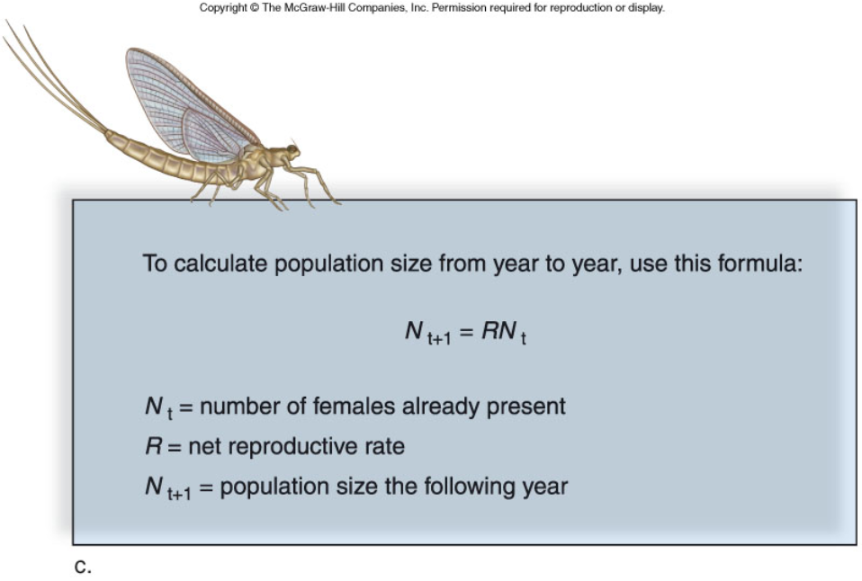
Consider that you have 10 females in a population that have a reproductive rate of 8, what will be the population in the subsequent years. Assume offspring are equally male and female.
Year 1 =
Year 2 =
Year 3 =
Year 4 =

Slide 32
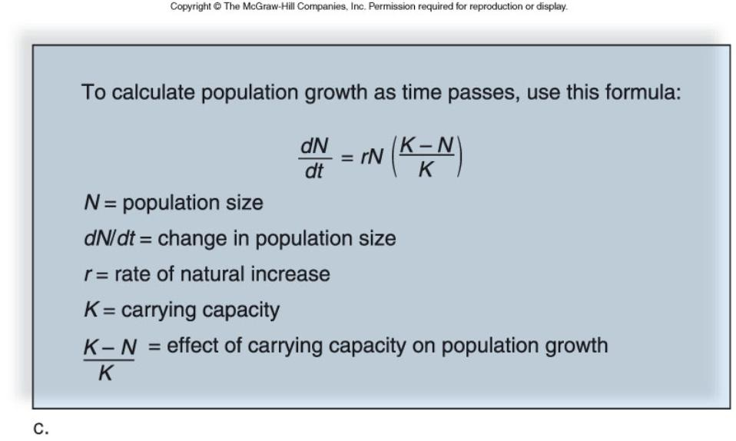
The logistic growth equation takes into account the carrying capacity (K).
*And you thought you’d never use a differential equation in real life!

Slide 33
Regulation of Population Size
Density Independent Factors: weather and other natural disasters (unrelated to population size)
Density Dependent Factors: food, space, water, parasitism, competition (get worse as population increases)

Slide 34
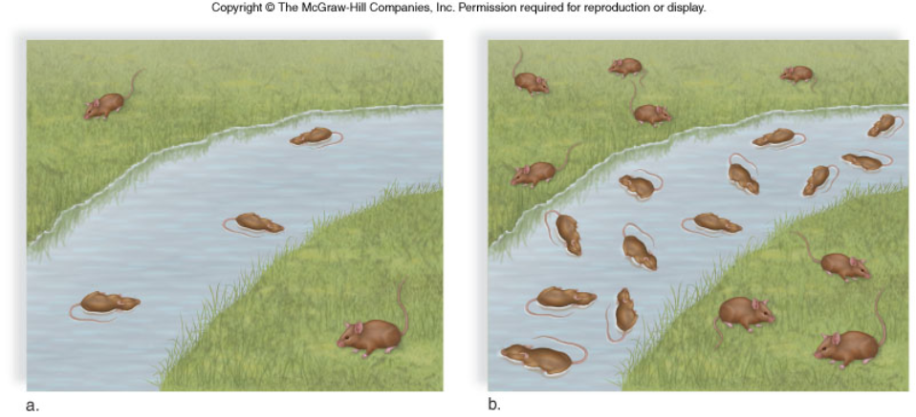
Figure 46.10
Density Independent Factor (Flash Flood) – it will have the same impact on a small pop as it does on a large pop.
60% loss for both

Slide 35
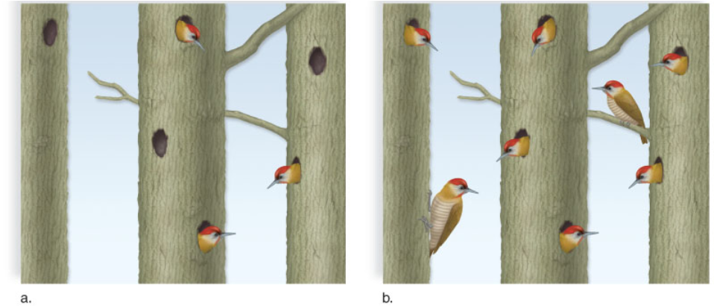
Figure 46.11
Density Dependent Factor – as number increases, not all of them will have access to resources

Slide 36
Life History Patterns
K-strategists - small numbers of offspring, usually parental care (ex - Kangaroo)
R-strategists - large numbers of offspring, no care, low survivability (ex - Roaches)

Slide 37
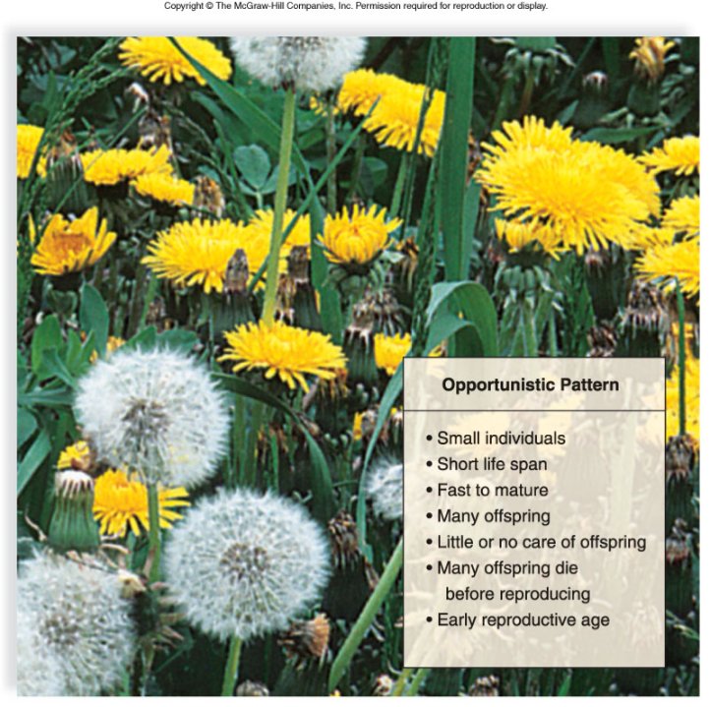
Figure 46.14a

Slide 38
